Slide 1
Software Development 3
Polymorphism Example

Slide 2
Subclass & Superclass Types
In the earlier example we saw that the SavingsAccount extends the class BankAccount
In other words, a SavingsAccount object is a special case of a BankAccount
Therefore, a reference to a SavingsAccount object can be converted to a BankAccount reference
SavingsAccount collegeFund = new SavingsAccount(10,10000);
BankAccount anAccount = collegeFund ;
Furthermore, all references can be converted to type object:
Object anObject = collegeFund;

Slide 3
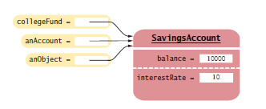
Subclass & Superclass Types
Now the three object references stored in collegeFund, anAccount, and anObject all refer to the same object of type SavingsAccount
The variables anAccount and anObject know less than the full story about the object references that they store
Why would we want to know less about an object reference and use a variable whose type is a superclass?
If we want to reuse code that knows about the superclass but not the subclass

Slide 4
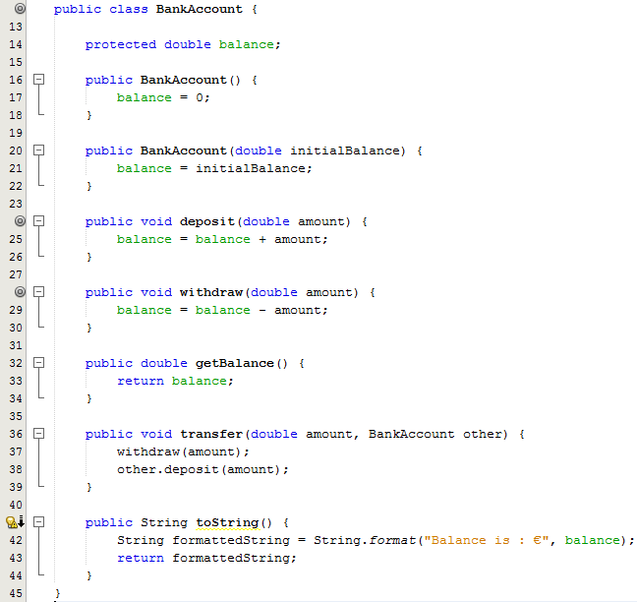
Example
Consider a transfer method that transfers money from account to another
The transfer method expects a reference to a BankAccount

Slide 5
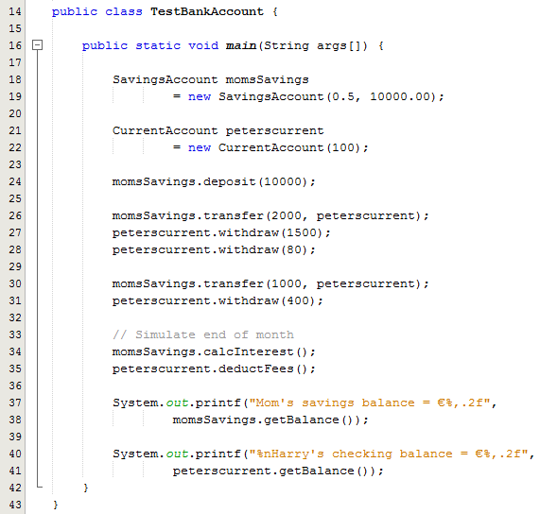
Example ctd
Line 26: We can call the transfer method to transfer money into Peters current account
The transfer method expects a reference to a BankAccount, and it gets a reference to a CurrentAccount object
This is perfectly legal
The transfer method is only concerned that the object can carry out the deposit method
This is assured because the other variable (Line 38 of the BankAccount class) has the type BankAccount

Slide 6
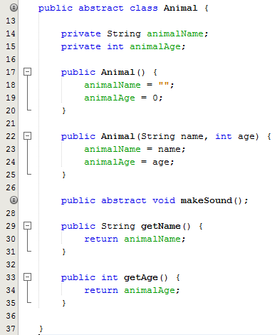
Polymorphism – Another Example
Abstract base class
Two private member variables
Default Constructor
Overloaded Constructed
Abstract makeSound() method
Getter methods

Slide 7
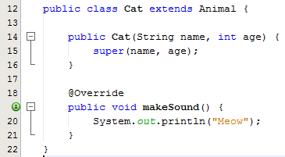
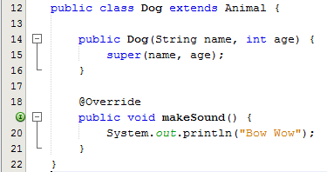
Example 1:Subclasses
Two subclasses Cat & Dog
Constructor with two parameters
Each sub class overrides the makeSound() method in the super class

Slide 8
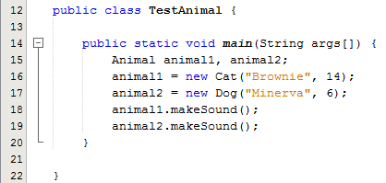
Example 1:Test Class
Line 15: Tells the JVM to allocate space for a two reference variables. The reference variables are both of type Animal.
Lines 16 & 17:
Tells the JVM to allocate space for a new Cat object and a new Dog object
Assigns the new Cat and the new Dog to the reference variables animal1and animal 2
Lines 18 & 19:
Polymorphic method call – the correct versions of the method gets called for each object

Slide 9
Example 2: Animal Base Class
Same class as before
Abstract base class
wo private member variables
Default Constructor
Overloaded Constructed
Empty makeSound() method
Two getter methods

Slide 10
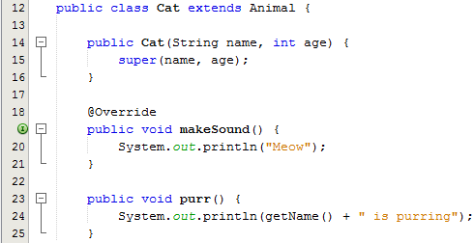
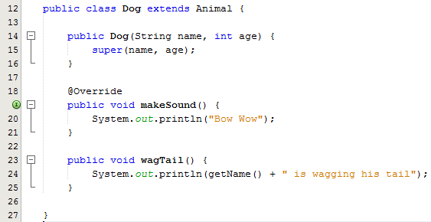
Example 2: Sub Classes
Two subclasses Cat & Dog
Constructor with one parameter
Each sub class overrides the makeSound() method in the super class
Cat class has a method called purr()
Dog class has a method called wagtail()

Slide 11
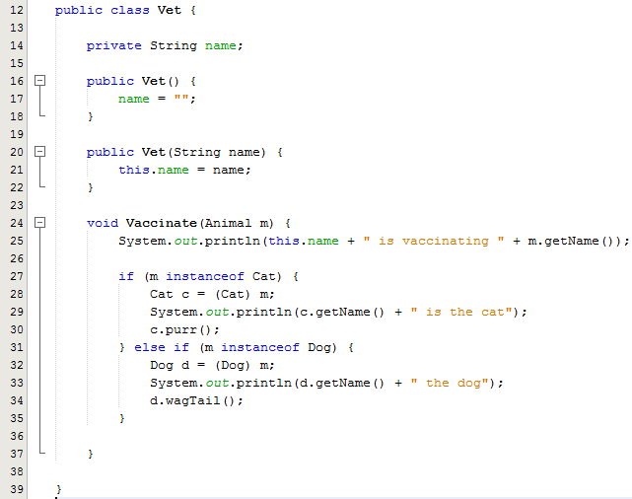
Example 2:Vet Class
Another unrelated class called Vet
Default Constructor
Overloaded Constructor
A Vaccinate method that accepts an object reference of type Animal as a parameter
The Animal parameter can take any animal type as the argument
In order to call the purr() and wagtail() methods we need to do an explicit cast down the hierarchy

Slide 12
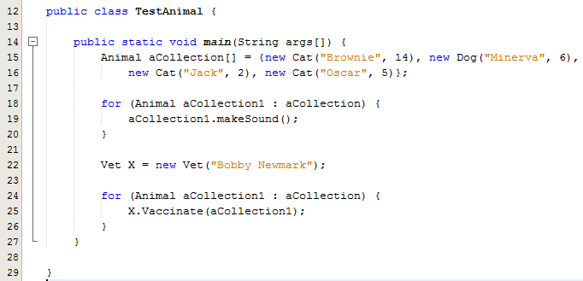
Example 2:Test Class
Line 15,16: Declares and initialises an array of type Animal with different Animal objects
Line 18: Enhance for loop iterates through the array and calls one of the Animal-class methods i.e. makeSound() and every object does the right thing
Line 22: Creates a new Vet object
Line 24: : Loops through the array and calls the Vaccinate() method. This method has an array element as a parameter which is an object reference

Slide 13
Equals versus == in Java
The .equals method is called whenever you want to compare whether two objects have the same contents
This is different from the test with the == operator, which tests whether the two references are to the same object
See example on the next slide

Slide 14
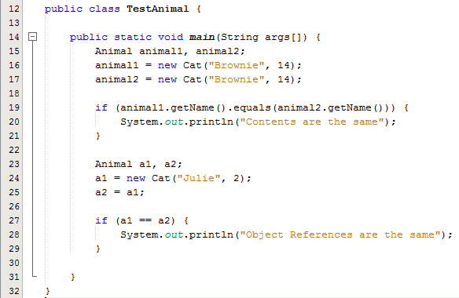
Equals versus == in Java
Line 19: Uses the equals method to check if the names of the cats match
Line 27: Use the == to check if a1 and a2 both reference the same object
Sample Output:
Contents are the same
Object References are the same

